Slide 1
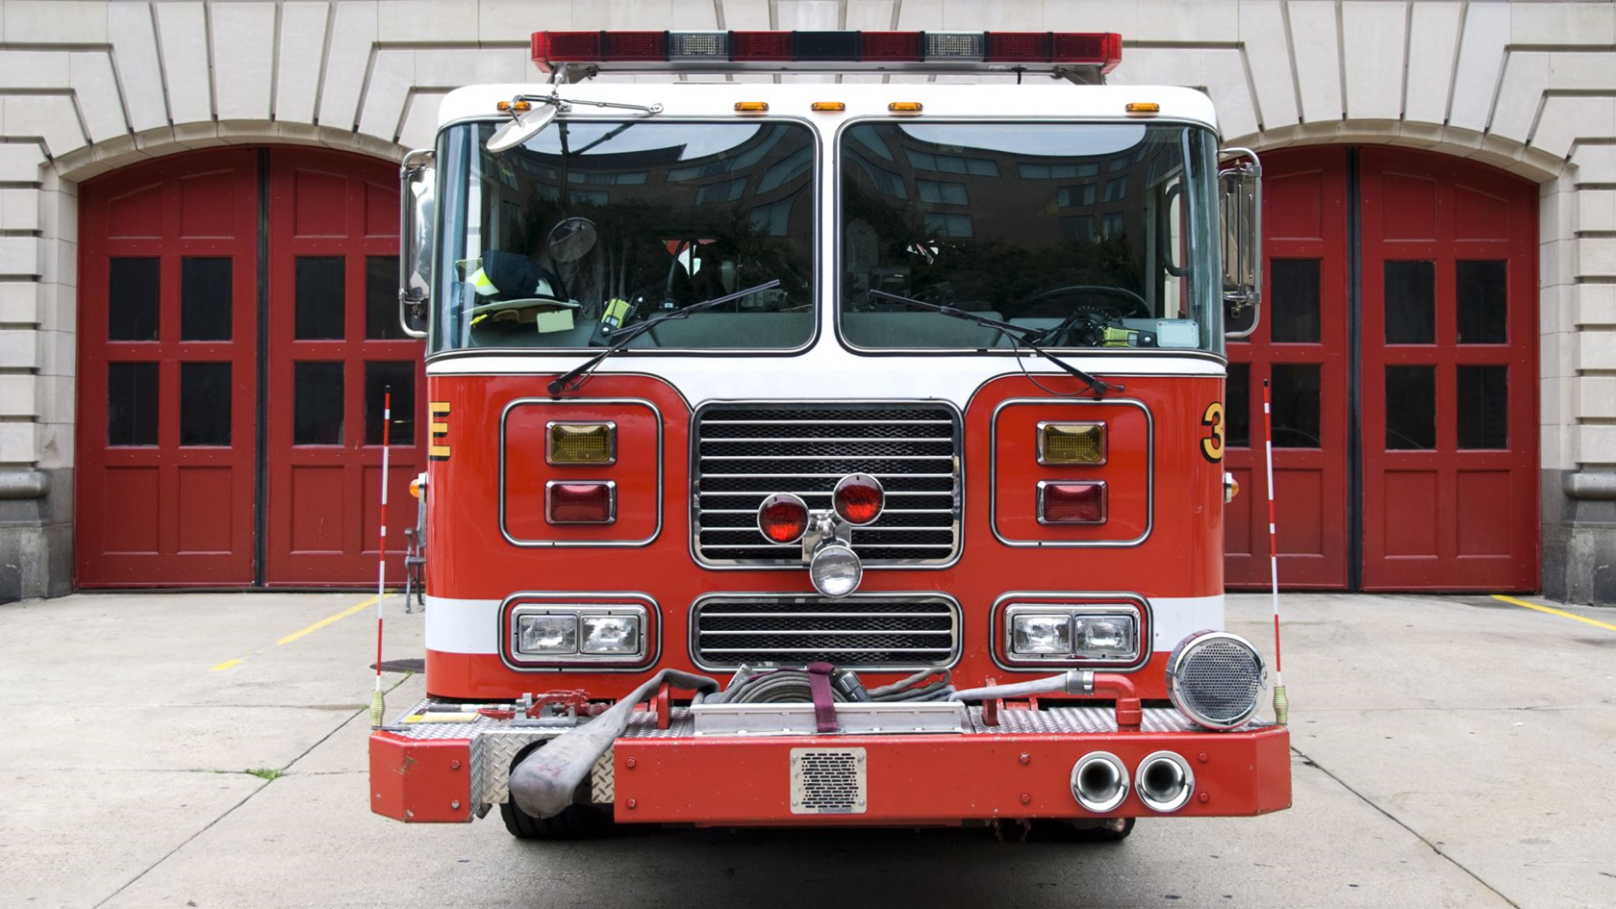
Fire-Related Information Pertaining to Western Australia Jens Weimann, Paul Roberts, Dale Hancke

Slide 2
Overview of Tools used
Data:
Data from the DFES Website (GeoJSON)
Data from the WA Volunteers Website and GoVolunteer (html sites)
Tools:
PostgreSQL
Leaflet
Html
JavaScript
Excel/CSV
Flask
Pandas
A JS library not used before – Custom Icons

Slide 3
Track chosen – 1 of 3:
P A combination of web scraping and Leaflet or Plotly
P A dashboard page with multiple charts that update from the same data
O A thick server that performs multiple manipulations on data in a database prior to visualization (to be approved)

Slide 4
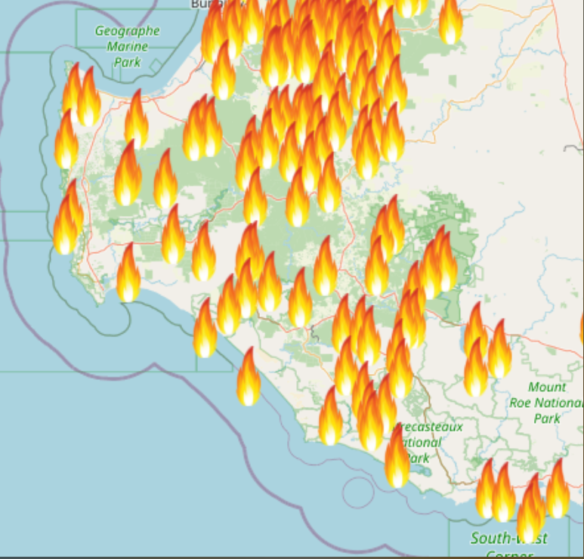
Coding Approach and Data Wrangling
Coding approach: split off a sample and get all the import coding to work with the sample before the main file.
Change polygons to single points to save data size
Think ahead before splitting the data into usable data tables

Slide 5
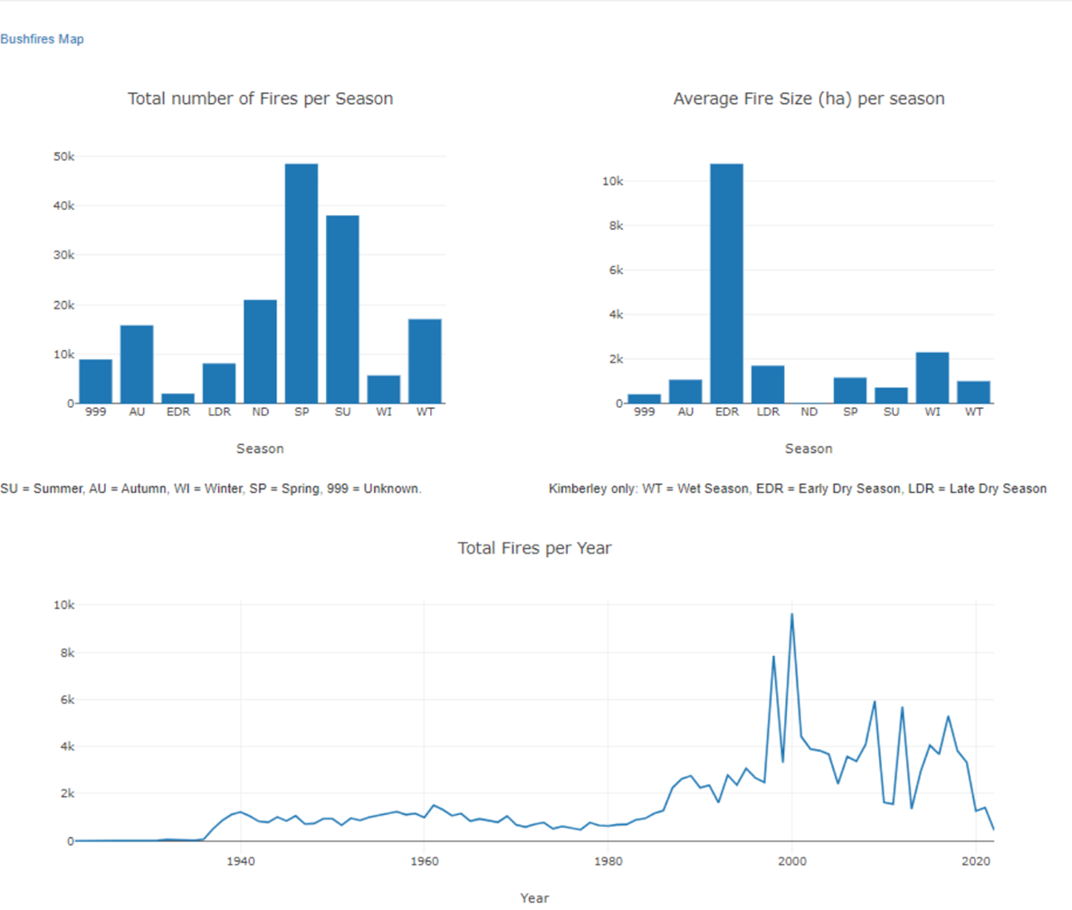
More Results

Slide 6
Coding Approach and Data Wrangling
Importing and converting GeoJSON to CSV to display properties data in a graph
Allows the size of polygons and location to be collated
Both the size of bushfires, and DFES zones can be displayed (in hectares)
The 10 largest areas are displayed on the HTML
Through Flask a local API can be established allowing GeoJSON data to be pulled through a link
The coordinates in the data allows areas to be produced on a map
Both street and topographic maps are used

Slide 7
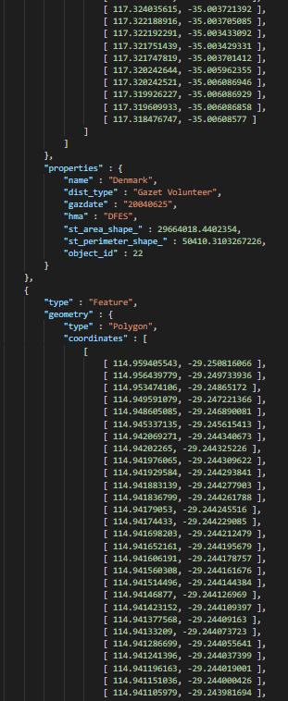
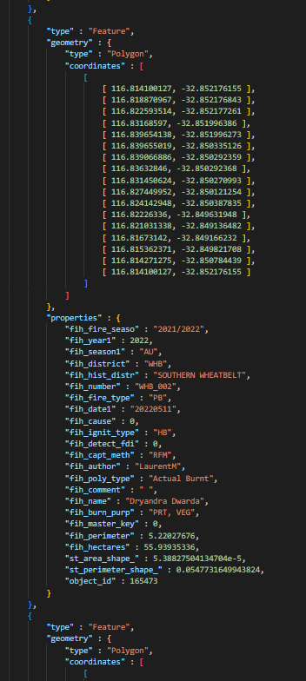
Coding Approach and Data Wrangling
Bushfire Data is of 100 most recent bushfires from the – Fire and Rescue Services District
Includes objects within objects to separate bushfire instances
DFES Zones consists of polygon data showing the DFES regional boundaries
Focuses on incident control management for specific LGA’s

Slide 8
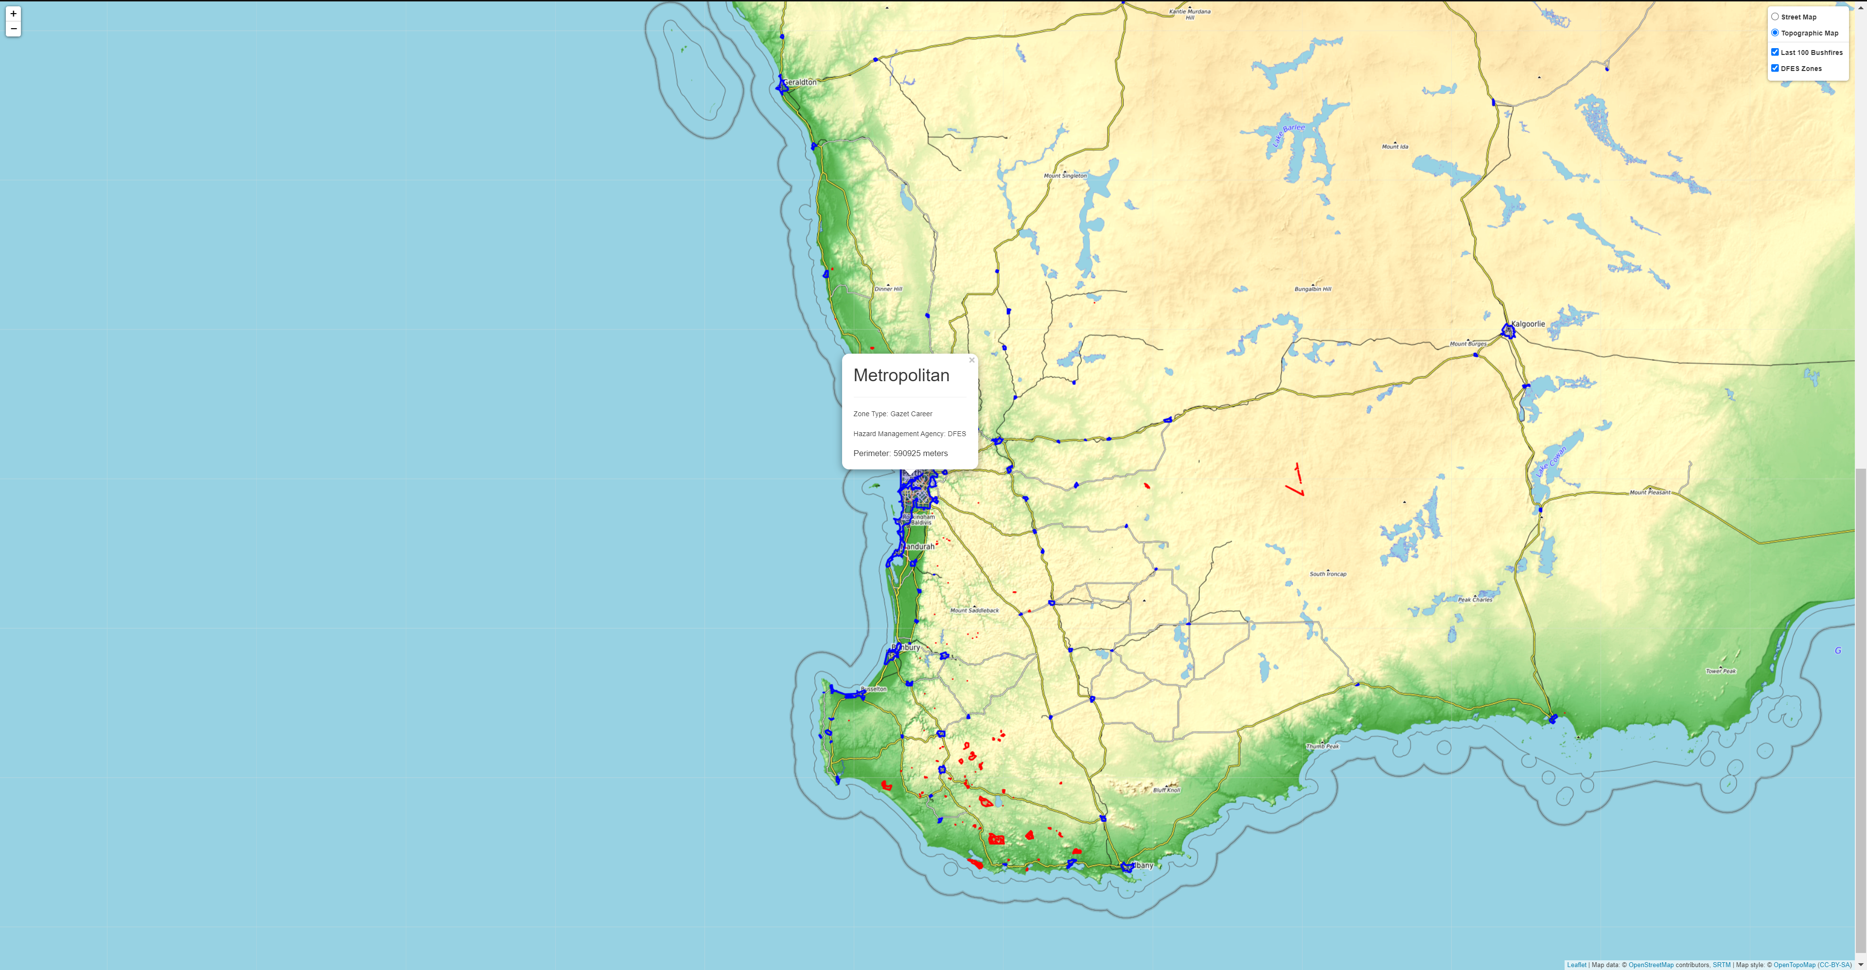
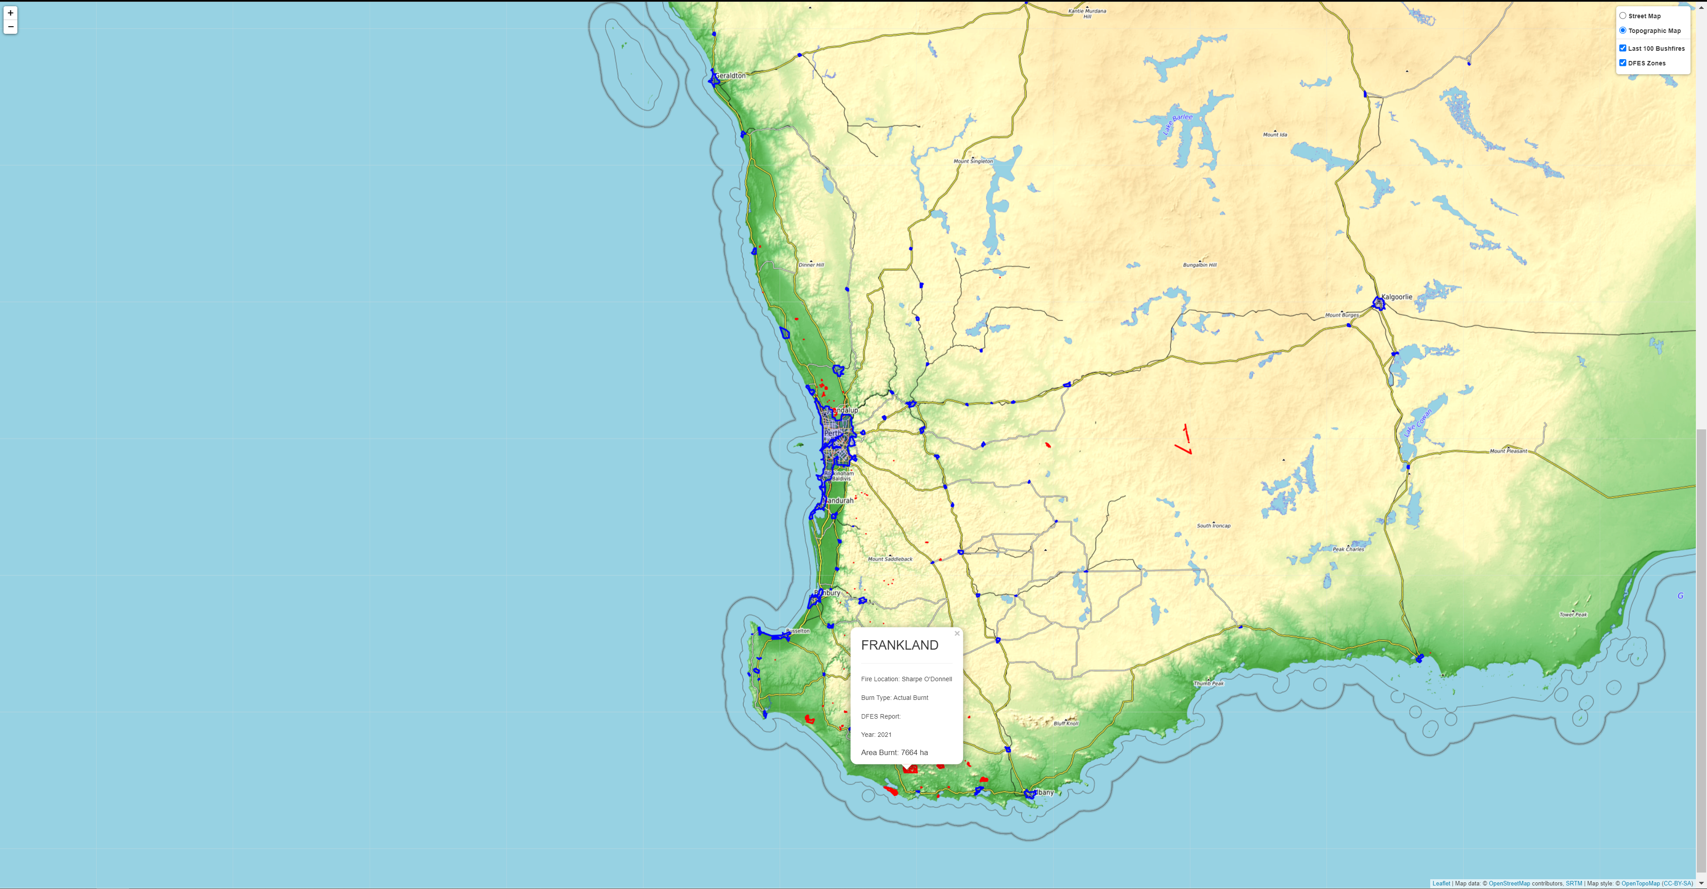
More Results
Map features:
10 Largest Bushfires in WA (2021-2022)
10 Largest DFES Zones in WA
Explanation for DFES and Bushfire data

Slide 9
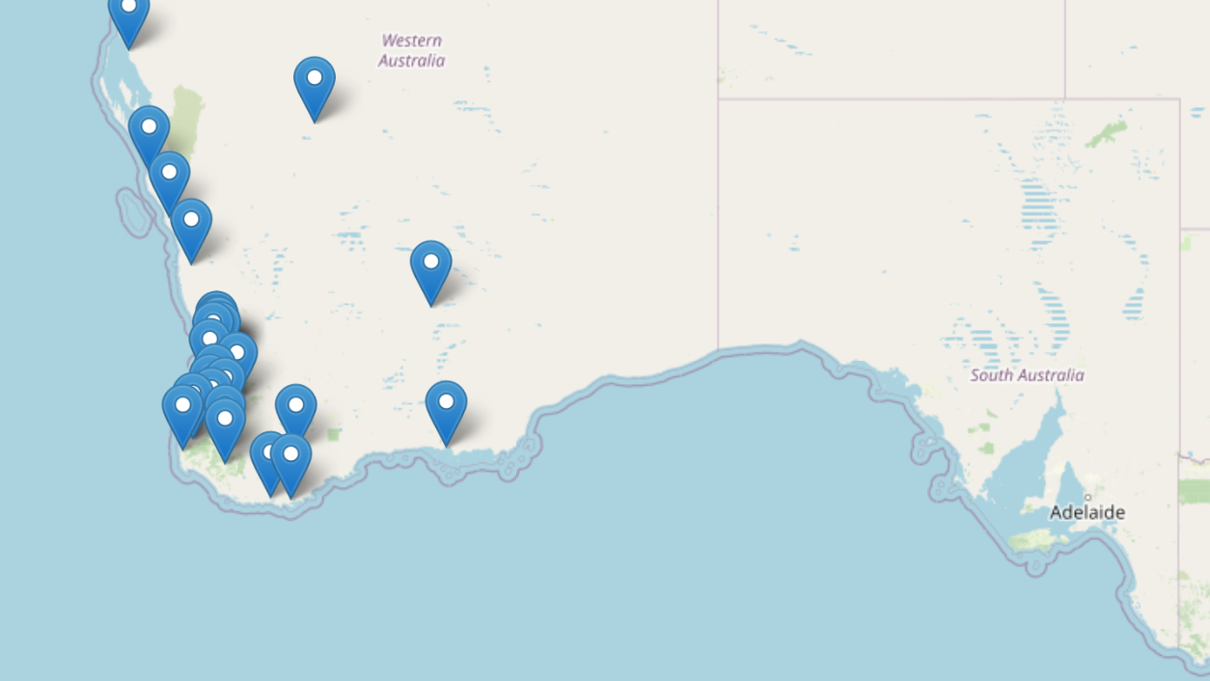
Fire Stations in WA

Slide 10
Objectives and Findings
To investigate the relationship between topographic features and bushfires
How does the state adapt to bushfire activities? Are LGA’s reasonable responsive
Looking into GeoJSON data provided by DFES, these characteristics can be visually displayed
Data is provided through “polygon” properties and allows zones to be presented through Nearmaps

Slide 11
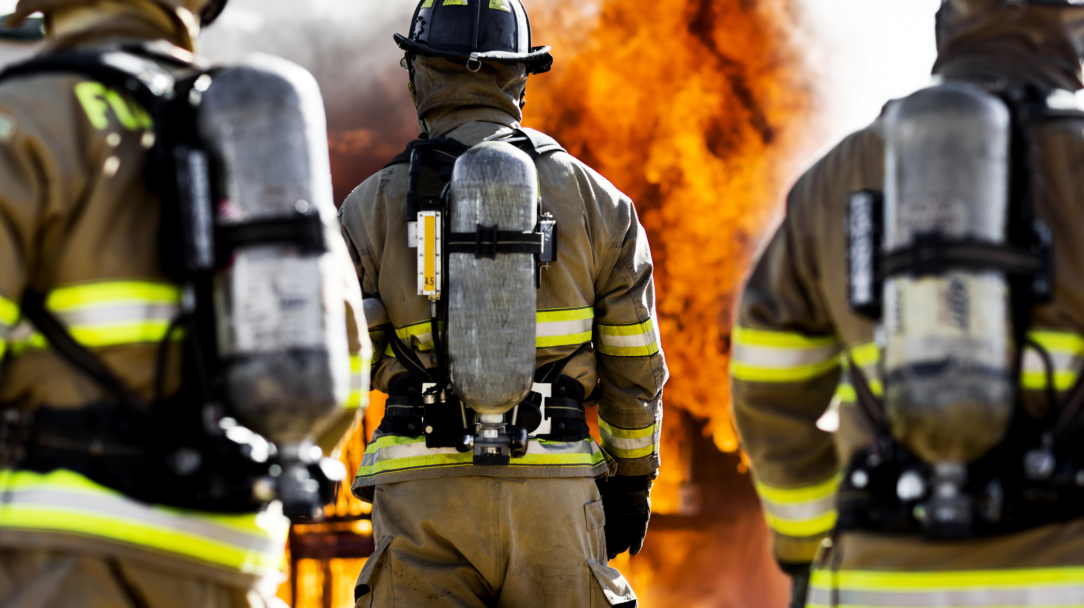
Thank you

